Slide 1
Design Review 5
Team 513
Automated Flux Reader (AFR)

Slide 2



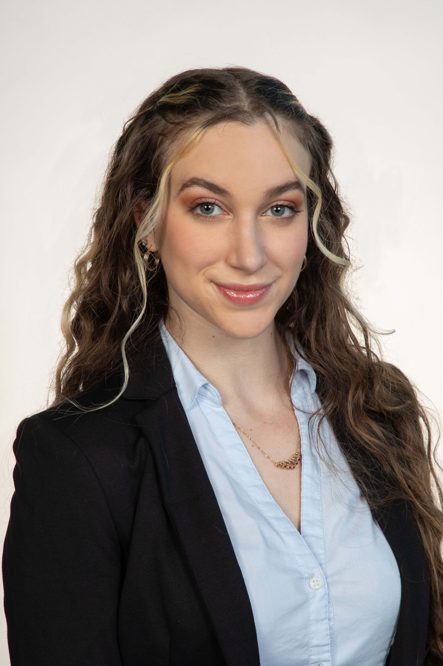
Team Introductions
Andrew Atallah
Andrew Atallah
Hardware & Software
Engineer
Sean Hemstreet
Design Engineer
Joshua Huls
Systems Engineer
Liora Louis
Materials &
Test Engineer

Slide 3




Sponsor and Advisor
Andrew Atallah
Engineering Mentor
William Bilbow
Director of Technology & Project Manager
Engineering Mentor
Cole Gray
Mechanical Design Engineer
Academic Advisor
Dr. Shayne McConomy
Senior Design Professor

Slide 4
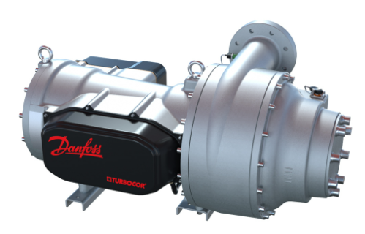
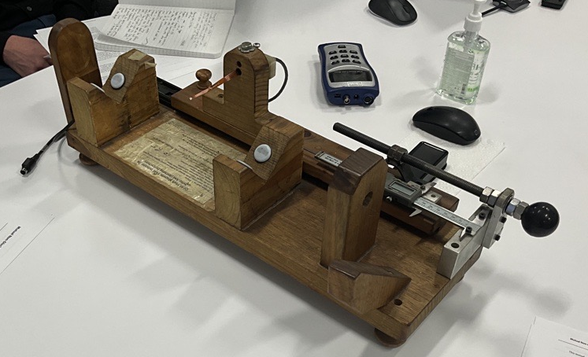
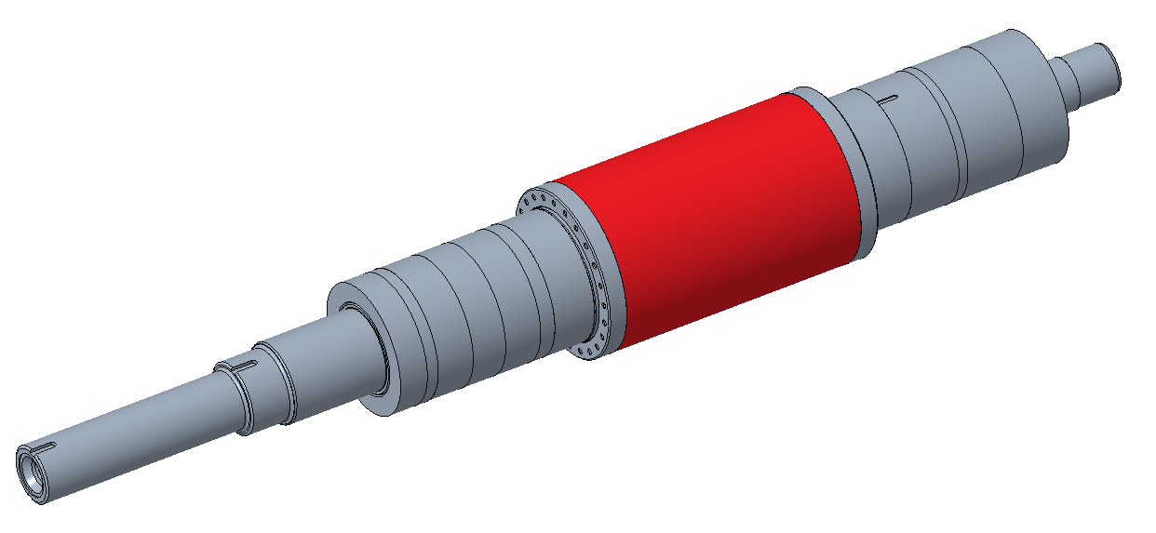
Objective
Andrew Atallah
The objective of this project is to design a device that will be capable of fully measuring and recording the magnetic flux of compressor shafts in an automated way that allows for accurate measurements, repeatability, and less overall firsthand work for the operator.

Slide 5




Key Goals
Andrew Atallah
Automation
Consistency
Adaptability
Accuracy

Slide 6
Assumptions
Andrew Atallah
Device is used over a period of 3 months per year.
Open-source software.
Given one working fluxmeter and sensor.
Testing will be performed at Danfoss.
Operator will be able to load shaft onto device.

Slide 7
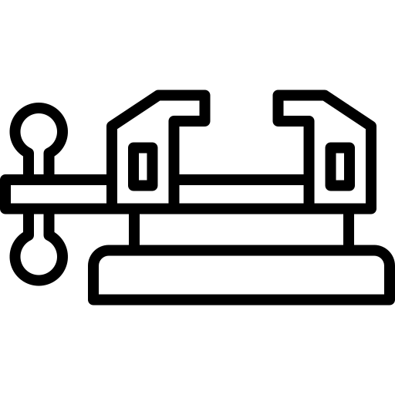





Targets and Metrics
Andrew Atallah
Secures Sample
Data Transfer
Repeatability
Resolution (5mm)
Structural Durability

Slide 8
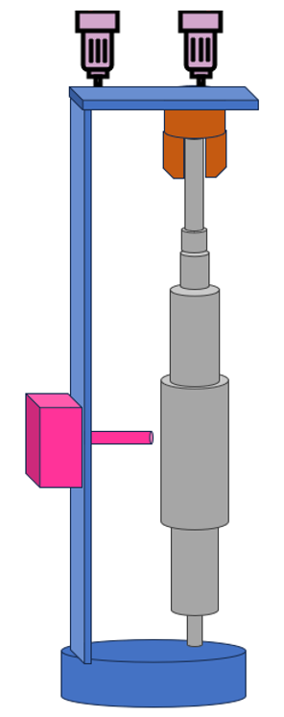
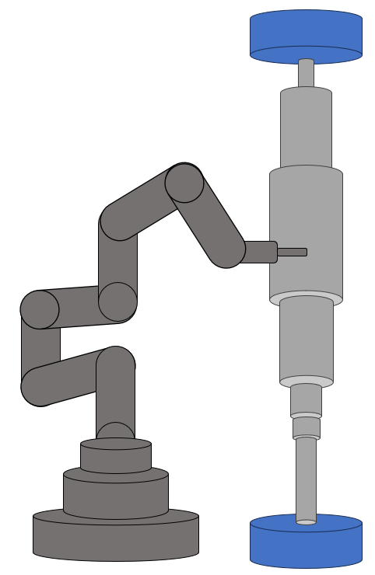
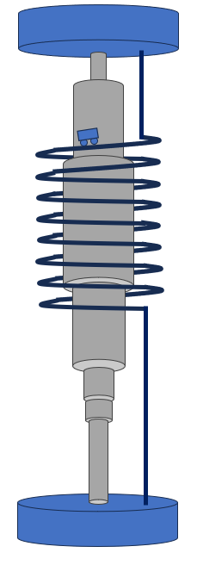
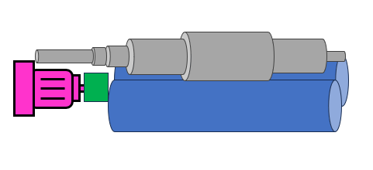
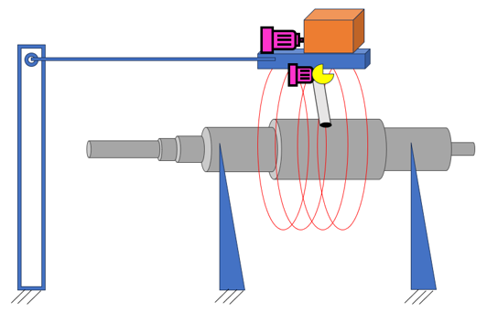
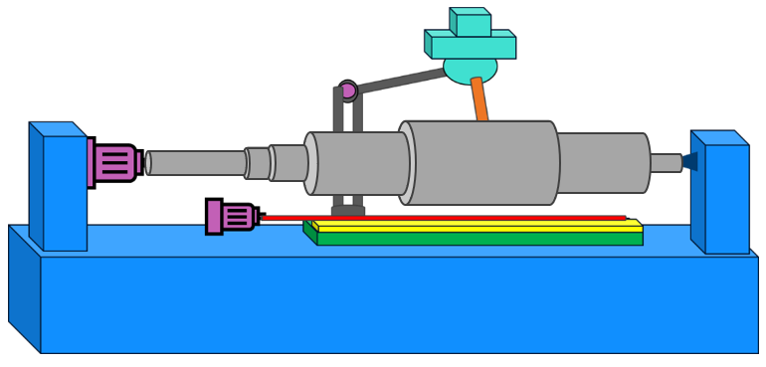
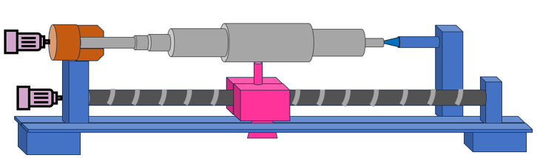
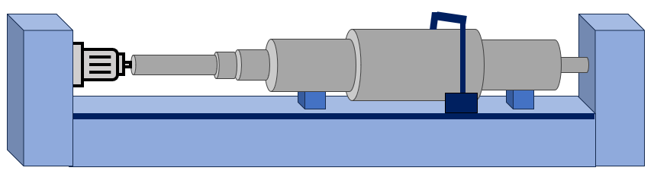
Concept Generation and Selection
Andrew Atallah
Generated 100 Concepts
Binary Pairwise Comparison
House of Quality (HoQ)
Pugh Charts
Analytical Hierarchy Process (AHP)

Slide 9

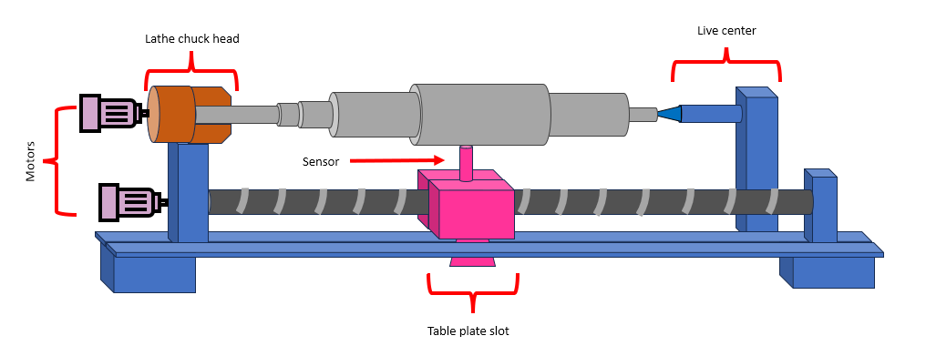


Selected Concept
Andrew Atallah
Reliable Measurement Feedback
Consistent Measurements
Measures Entire Region
Secures and Levels Sample
Horizontal Lathe
Adaptable

Slide 10
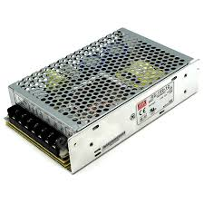

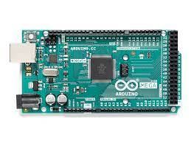
Process Mapping
Andrew Atallah
1. Start Program
2. Activate Arduino and Power Supply
Arduino
3. Data Acquisition
Fluxmeter
Stepper Motors

Slide 11
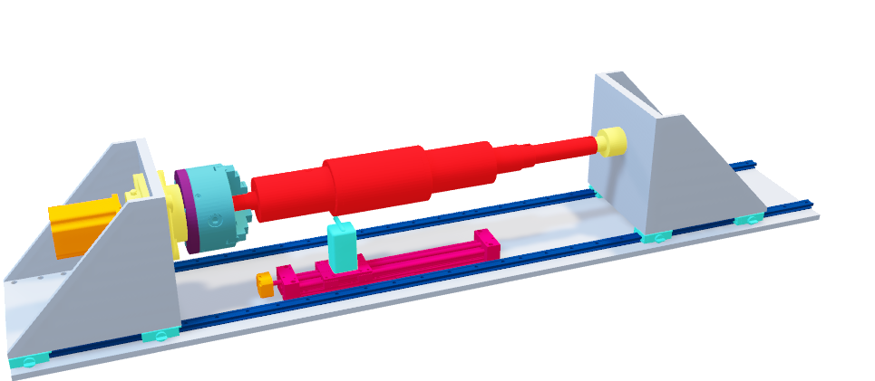
Initial Design
Sean Hemstreet
Design Elements
Two Triangle Bracket Supports
1
Custom Chuck Head Assembly
2
Live Center
3
Tracks to Move the Brackets
4
Linear Guide Rail
5

Slide 12
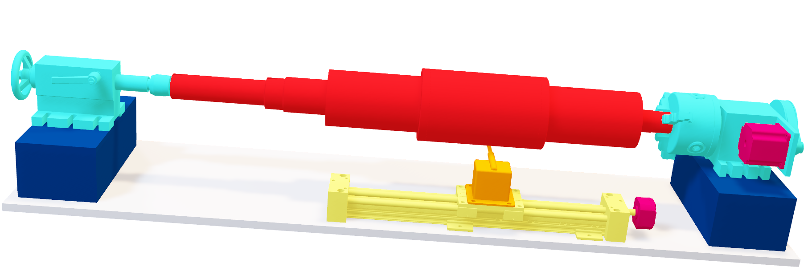
Design Iterations
Sean Hemstreet
New Design Benefits
1
2
3
4
5

Slide 13

Design Iterations
Sean Hemstreet
New Design Benefits
No tracks needed
1
2
3
4
5

Slide 14
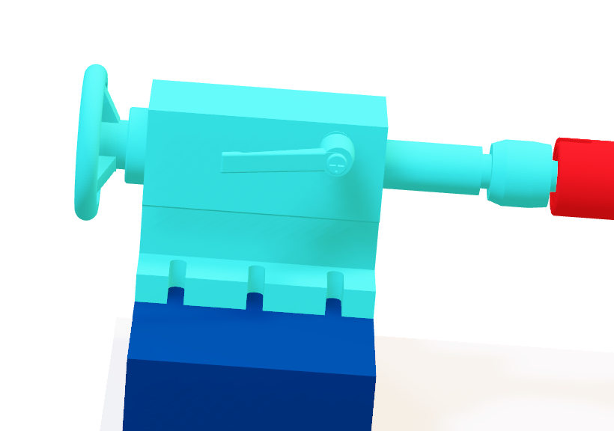
Design Iterations
Sean Hemstreet
New Design Benefits
No tracks needed
1
Adjustable tailstock with wheel
2
3
4
5

Slide 15
Design Iterations
Sean Hemstreet
New Design Benefits
No tracks needed
1
Adjustable tailstock with wheel
2
Singular lever lock for live center
3
4
5

Slide 16
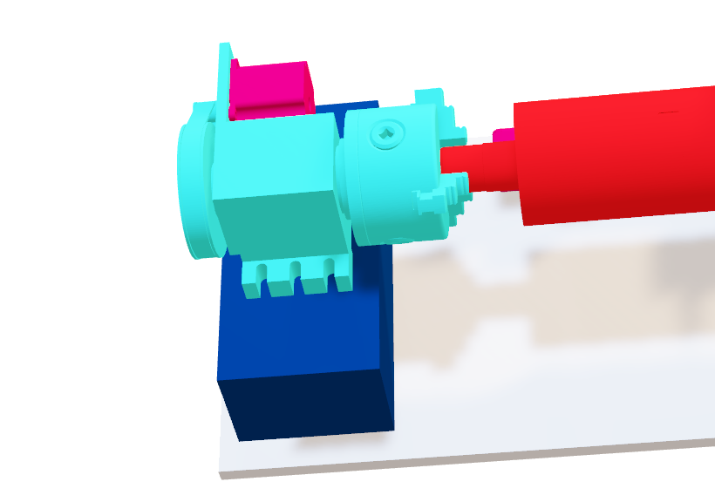
Design Iterations
Sean Hemstreet
New Design Benefits
No tracks needed
1
Adjustable tailstock with wheel
2
Singular lever lock for live center
3
Preassembled powered chuck head
4
5

Slide 17
Design Iterations
Sean Hemstreet
New Design Benefits
No tracks needed
1
Adjustable tailstock
2
Singular lever lock for live center
3
Preassembled powered chuck head
4
Identical aluminum block for support
5

Slide 18
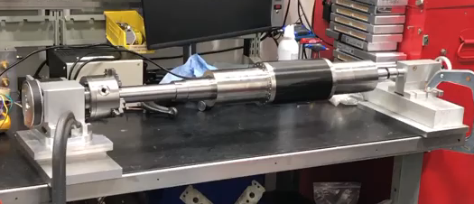
Testing and Validation
Sean Hemstreet
Confirmed the chuck head was large enough
Confirmed the tailstock and live center were strong enough
Confirmed the NEMA 23 motor was more than capable

Slide 19






Building Structure
Sean Hemstreet
Up Next
Machining baseplate
Installing aluminum blocks
Attaching chuck head and tailstock
Securing linear guide rail
Mounting flux meter probe

Slide 20




Budget Breakdown
Sean Hemstreet
Remaining Budget
Structural Components
75%
25%
79%
21%
Money Spent
Electronics

Slide 21
Future Work
Sean Hemstreet
Assembly of Device
Test Preliminary Code
Ensure Ordering is Complete
Perform Test Runs

Slide 22

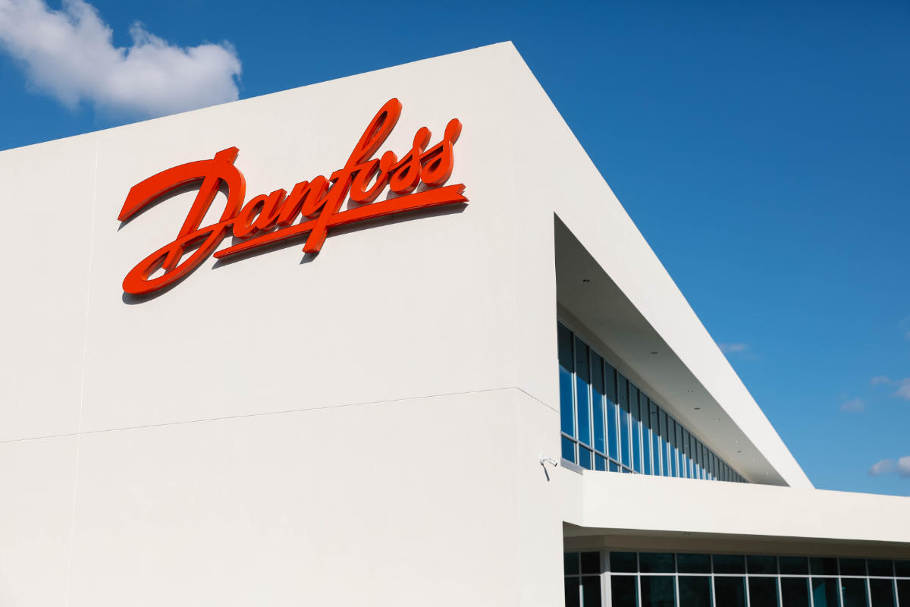




Automated Flux Reader
Sean Hemstreet
Andrew Atallah
Sean Hemstreet
Joshua Huls
Liora Louis

Slide 23
This is 10-point
This is 15–point Times
This is 20–point
This is 25–point
This is 30–point
This is 35–point
This is 40–point
This is 50–point
This is 60–point
This is 72–point
Notes:
Use at least 20-point font in Room A105, B134, and B136
Use at least 25-point font in Room B135

Slide 24
College of Engineering Color Palette
1 2 3 4
Pantone: PMS 195 C
RGB: 120, 47, 64
Hex: #782F40
CMYK:19, 90, 50, 55
1 2 3 4
Pantone: Black C
RGB: 0, 0, 0
Hex: #000000
CMYK:0, 0, 0, 100
Garnet
Black
1 2 3 4
RGB: 238, 118, 36
Hex: #EE7624
CMYK:2, 66, 99, 0
1 2 3 4
Pantone: PMS 000C
RGB: 255, 255, 255
Hex: #FFFFFF
CMYK: 0, 0, 0, 0
Fang
Orange
White
Notes:
Avoid 75% Black in B135

Slide 25
Accent Color Palette
1 2 3 4
RGB: 0, 59, 111
Hex: #003B6F
CMYK:
1 2 3 4
RGB: 0, 59, 111
Hex: #003B6F
CMYK:
1 2 3 4
RGB: 251, 236, 93
Hex: #FBEC5D
CMYK:
1 2 3 4
RGB: 219, 215, 210
Hex: #DBD7D2
CMYK:
1 2 3 4
RGB: 251, 236, 93
Hex: #FBEC5D
CMYK:
1 2 3 4
RGB: 219, 215, 210
Hex: #DBD7D2
CMYK:
Tardis Blue
Tardis Blue
Corn
Timberwolf
Corn
Timberwolf
1 2 3 4
RGB: 206, 0, 88
Hex: #CE0058
CMYK: 0, 100, 43, 12
1 2 3 4
RGB: 206, 0, 88
Hex: #CE0058
CMYK: 0, 100, 43, 12
1 2 3 4
RGB: 104, 40, 96
Hex: #682860
CMYK:
1 2 3 4
RGB: 220, 220, 220
Hex: #DCDCDC
CMYK:
Rubine Red
Rubine Red
Imperial
Gainsboro
1 2 3 4
RGB: 72, 146, 155
Hex: #48929b
CMYK:
1 2 3 4
RGB: 64, 224, 208
Hex: #40E0D0
CMYK:
1 2 3 4
RGB: 255, 139, 0
Hex: #FF8B00
CMYK:
Asagi-iro
Turquoise
American Orange
Notes:
Remove American orange add hyperlink grey
Make corn the last for b135
All work in 134 imperial move later
Tardis doesn’t work in b136

Slide 26
F7AB19
D67F15
EE7624
D64615
F73119
Analogous
https://color.adobe.com/create/color-wheel
6E3610
F0A16C
EE7624
6E4931
BASB1C
Monochromatic
A14508
4BED3B
EE7624
250CED
2010A1
Triad
A1470C
FF8C40
EE7624
0098A1
24E2ED
Complementary
28A164
2FED8D
EE7624
0848A1
1871ED
Split Complementary
EDAC2F
3BED93
EE7624
0C6AED
ED2F18
Double Split Complementary
ED660C
C7ED3B
EE7624
0CE1ED
A418ED
Square
BA7E09
87724A
EE7624
60EFCF
09BA61
Compound
AD551A
6E3610
EE7624
FA7625
D46820
Shades
Notes:
These are the variants that work well with Fang Orange. The bolded items show well on the projectors.

Slide 27
85412D
8F3831
782f40
8F3176
792D85
Analogous
https://color.adobe.com/create/color-wheel
C44D69
8E626D
782F40
C48796
451B25
Monochromatic
C43959
78743B
782F40
236178
43A2C4
Triad
C43959
C46078
782F40
25C43D
2F783A
Complementary
93C460
577835
782F40
39C49D
297861
Split Complementary
784435
5A783B
782F40
237860
6E2978
Double Split Complementary
782337
78683b
782F40
237830
293978
Square
AB4D32
DEBAAF
782F40
5D8555
70AB32
Compound
38161E
C44D69
782F40
853447
5E2532
Shades

Slide 28
A105
A105
B135 Stage Left
B135 Stage Right
B136
B134, A105
B135

